Slide 1
Distributed shared memory

Slide 2
What we’ve learnt so far
MapReduce/Dryad as a distributed programming model
Data-flow (computation as vertex, data flow as edge)
No shared global state
Very successful
Programmers code application logic
Runtime deals with distribution, load-balancing, failures

Slide 3
Need for global shared state
Allows for a more natural programming style
We are familiar with (single-machine) shared-memory
Allows for online applications
Shared state → instant state access
Data-flow → batch computation
More efficient
Shared state → intermediate state reside in memory
Data-flow → intermediate results stored in distributed file system

Slide 4
Motivating Example: PageRank
for each node X in graph:
for each edge X→Z:
next[Z] += curr[X]
Repeat until
convergence
Fits in memory!
Input Graph
Curr
Next
A→B,C,D
B→E
C→D
…
A: 0.25
B: 0.17
C: 0.22
…
A: 0.12
B: 0.15
C: 0.2
…
A: 0.2
B: 0.16
C: 0.21
…
A: 0
B: 0
C: 0
…
A: 0.2
B: 0.16
C: 0.21
…
A: 0.25
B: 0.17
C: 0.22
…
Notes:
For the purposes of the this talk, we’er egoing to focus on applications where this mutable part of the state fits in memory

Slide 5
PageRank in MapReduce
Data flow models do not expose global state.
1
Graph stream
Rank stream
Rank stream
A->B,C, B->D
A:0.1, B:0.2
A:0.1, B:0.2
Distributed Storage
2
3
Notes:
Talk about global file system
The only way to share state in MapReduce is via the storage system
For some applications, this is really inefficient
And some applications this doesn’t work at all; talk about distributed crawler

Slide 6
PageRank in MapReduce
Data flow models do not expose global state.
1
Graph stream
Rank stream
Rank stream
A->B,C, B->D
A:0.1, B:0.2
A:0.1, B:0.2
Distributed Storage
2
3
Notes:
Talk about global file system
The only way to share state in MapReduce is via the storage system
For some applications, this is really inefficient
And some applications this doesn’t work at all; talk about distributed crawler

Slide 7
Alternative model for sharing state?
MPI (Message Passing interface)
Commonly used by the supercomputing community
Higher-level API than sockets
Point-to-point and point-to-multipoint send/receive
Synchronizing nodes (barriers)
Obtaining meta information (e.g. # of processes in session)

Slide 8
PageRank With MPI/RPC
Graph
A->B,C
…
Ranks
A: 0
…
User explicitly programs communication
1
Distributed Storage
Ranks
C: 0
…
Ranks
B: 0
…
Graph
C->E,F
…
2
3
Graph
B->D
…

Slide 9
Why not MPI?
Too low-level
Users are burdened with
Partitioning computation among nodes
Fetch/serve state from/to remote nodes
Load-balancing
Failure handling

Slide 10
Distributed shared memory: goal
Distributed Storage
Distributed in-memory state
1
read/write
Ranks
A: 0
B: 0
…
Graph
A->B,C
B->D
…
2
3

Slide 11
DSM’s goal:
Graph
A->B,C
…
Ranks
A: 0
…
Runtime handles communication
1
Ranks
C: 0
…
Ranks
B: 0
…
Graph
C->E,F
…
2
3
Graph
B->D
…

Slide 12
Distributed shared memory
Landmark DSM systems:
We’ve seen one in an earlier class
Today: Treadmarks
Challenges of DSM systems:
Ease-of-use (memory consistency model, synchronization)
Performance

Slide 13
Treadmarks
Abstraction for sharing
Memory-page level, load/store operations
Treadmarks addresses specific DSM problems
False sharing of pages
Reduce write traffic

Slide 14
Idea #1: Write-diffs
Why write-diffs?
Are they identical to object/variable granularity than page-level granularity?
Can we use write-diffs with sequential consistency?

Slide 15
Idea #2: relaxed consistency model
Release consistency
When are writes propagated?
Lazy release consistency
Why RC/LRC?
CPU0: while (1) acq(L1) writes to x[0…1000] rel(L1)
CPU1: while (1) acq(L2) writes to x[1001…2000] rel(L2)

Slide 16
More Examples of RC, LRC
CPU0: acq(L1) x=1rel(L1)
CPU1: acq(L1) y=x rel(L1)
CPU2: acq(L1) print x,y rel(L1)

Slide 17
Write PageRank using TreadMarks?

Slide 18
Piccolo: a DSM at higher abstraction

Slide 19
Programming Model
Implemented as library for C++ and Python
1
x
get/put
update/iterate
read/write
Ranks
A: 0
B: 0
…
Graph
A→B,C
B→D
…
2
3
Notes:
Main challenge with distributed state is access to remote state then local state
Additionally synchronizing this access across different machines is slow
For applications to be efficient, our runtime needs help from programmers to exploit locality of access and avoid frequent synchronization.
Load/store is too level to express these hints.
Our insight is to use a key-value interface; get/put/ and iteration primitives. As we’ll see later, this allows us to express the required hints to achieve good performance.
This is implemented this as a library to existing languages.

Slide 20
Naïve PageRank with Piccolo
curr = Table(key=PageID, value=double)
next = Table(key=PageID, value=double)
def pr_kernel(graph, curr, next):
i = my_instance
n = len(graph)/NUM_MACHINES
for s in graph[(i-1)*n:i*n]
for t in s.out:
next[t] += curr[s.id] / len(s.out)
Jobs run by many machines
def main():
for i in range(50):
launch_jobs(NUM_MACHINES, pr_kernel,
graph, curr, next)
swap(curr, next) next.clear()
Controller launches jobs in parallel
Run by a single
controller
Notes:
Mention this looks like Python psuedo-code.
Highlighted are the api calls
Maybe change accesses into gets
Emphasize how easy this is

Slide 21
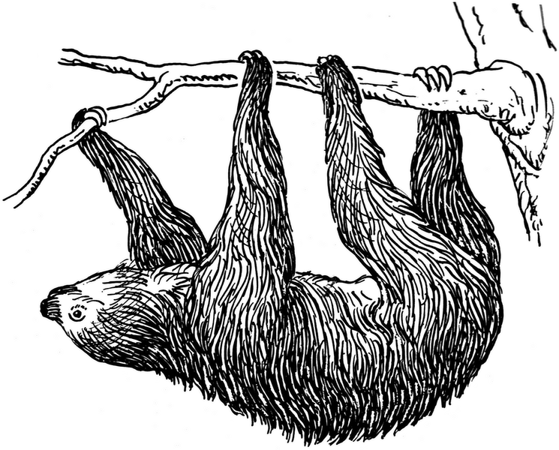
Naïve PageRank is Slow
get
Graph
B->D
…
Ranks
A: 0
…
1
put
get
get
put
put
Ranks
C: 0
…
Ranks
B: 0
…
Graph
C->E,F
…
2
3
Graph
A->B,C
…

Slide 22
PageRank: Exploiting Locality
curr = Table(…,partitions=100,partition_by=site)
next = Table(…,partitions=100,partition_by=site)
group_tables(curr,next,graph)
def pr_kernel(graph, curr, next):
for s in graph.get_iterator(my_instance)
for t in s.out:
next[t] += curr[s.id] / len(s.out)
def main():
for i in range(50):
launch_jobs(curr.num_partitions,
pr_kernel,
graph, curr, next,
locality=curr)
swap(curr, next)
next.clear()
Control table partitioning
Co-locate tables
Co-locate execution with table
Notes:
Get_iterator fix.
Try overlaying the old one with the new one
As we can see, this is a relatively simple

Slide 23
Exploiting Locality
get
Graph
B->D
…
Ranks
A: 0
…
1
put
get
get
put
put
Ranks
C: 0
…
Ranks
B: 0
…
Graph
C->E,F
…
2
3
Graph
A->B,C
…

Slide 24
Exploiting Locality
get
Graph
B->D
…
Ranks
A: 0
…
1
put
get
get
put
put
Ranks
C: 0
…
Ranks
B: 0
…
Graph
C->E,F
…
2
3
Graph
A->B,C
…

Slide 25
Synchronization
1
How to handle synchronization?
Graph
B->D
…
Ranks
A: 0
…
put (a=0.3)
Ranks
C: 0
…
put (a=0.2)
Ranks
B: 0
…
Graph
C->E,F
…
2
3
Graph
A->B,C
…

Slide 26
Synchronization Primitives
Avoid write conflicts with accumulation functions
NewValue = Accum(OldValue, Update)
sum, product, min, max
→Global barriers are sufficient
Tables provide release consistency
Notes:
This is like release consistency
Users provide an
This is very similar to the reduce/combine function from MapReduce – we’ve pulled that into the shared state context
These primitive operations and semantics allow us to implement very effcient applications, buffering and merging results
Accumulation functions must commute!
Most programs are written to avoid them
Some are okay with these conflicts if ops are atomic

Slide 27
PageRank: Efficient Synchronization
Accumulation via sum
curr = Table(…,partition_by=site,accumulate=sum)
next = Table(…,partition_by=site,accumulate=sum)
group_tables(curr,next,graph)
def pr_kernel(graph, curr, next):
for s in graph.get_iterator(my_instance)
for t in s.out:
next.update(t, curr.get(s.id)/len(s.out))
def main():
for i in range(50):
handle = launch_jobs(curr.num_partitions,
pr_kernel,
graph, curr, next,
locality=curr)
barrier(handle)
swap(curr, next)
next.clear()
Update invokes accumulation function
Explicitly wait between iterations

Slide 28
Efficient Synchronization
1
Runtime computes sum
Graph
B->D
…
Ranks
A: 0
…
Workers buffer updates locally
→ Release consistency
put (a=0.3)
update (a, 0.3)
put (a=0.2)
Ranks
C: 0
…
update (a, 0.2)
Ranks
B: 0
…
Graph
C->E,F
…
2
3
Graph
A->B,C
…

Slide 29
PageRank with Checkpointing
curr = Table(…,partition_by=site,accumulate=sum)
next = Table(…,partition_by=site,accumulate=sum)
group_tables(curr,next)
def pr_kernel(graph, curr, next):
for node in graph.get_iterator(my_instance)
for t in s.out:
next.update(t,curr.get(s.id)/len(s.out))
def main():
curr, userdata = restore()
last = userdata.get(‘iter’, 0)
for i in range(last,50):
handle = launch_jobs(curr.num_partitions, pr_kernel,
graph, curr, next,
locality=curr)
cp_barrier(handle, tables=(next), userdata={‘iter’:i})
swap(curr, next)
next.clear()
Restore previous computation
User decides which tables to checkpoint and when
Notes:
Checkpoints are global!!!!

Slide 30
Recovery via Checkpointing
1
Graph
B->D
…
Ranks
A: 0
…
Distributed Storage
Runtime uses Chandy-Lamport protocol
Ranks
C: 0
…
Ranks
B: 0
…
Graph
C->E,F
…
2
3
Graph
A->B,C
…

Slide 31
Load Balancing
Other workers are updating P6!
J1, J2
J3, J4
J5, J6
J1
P1, P2
J3
P3, P4
J6
P5, P6
P1
P3
P5
P6
1
2
3
J3
J5
Pause updates!
master
Coordinates work-stealing

Slide 32
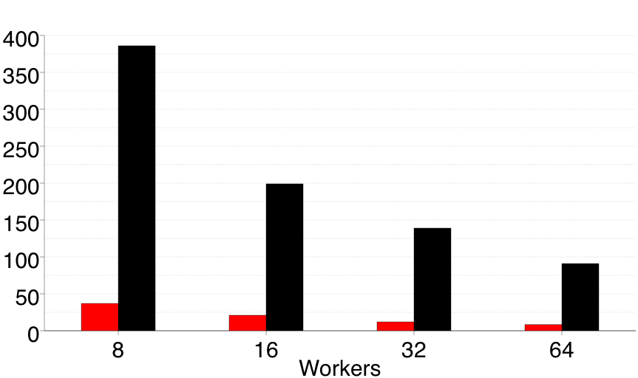
Piccolo is Fast
Main Hadoop Overheads:
Sorting
HDFS
Serialization
Hadoop
Piccolo
PageRank iteration time
(seconds)
NYU cluster, 12 nodes, 64 cores
100M-page graph
Notes:
Why is hadoop slower?
We profiled and optimized this Hadoop implementation, afterwards the 3 main slowdowns were:
Sorting
HDFS
Serialization
All three are reduced or eliminated in the Piccolo version

Slide 33
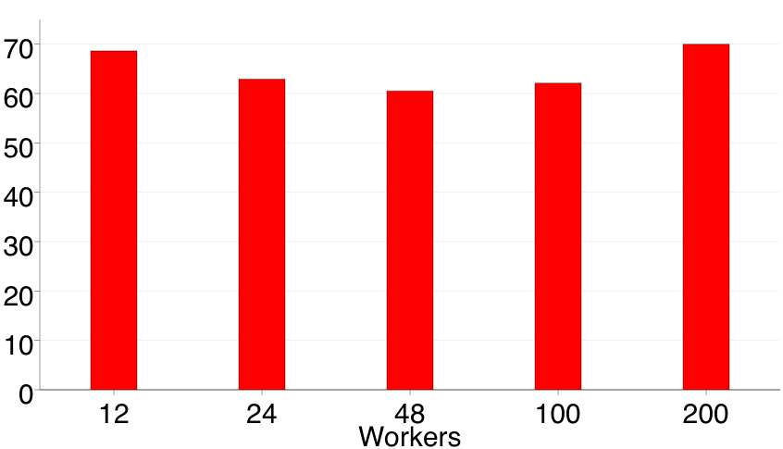
Piccolo Scales Well
1 billion page graph
ideal
PageRank iteration time
(seconds)
EC2 Cluster - linearly scaled input graph

Slide 34
Other applications
Iterative Applications
N-Body Simulation
Matrix Multiply
Asynchronous Applications
Distributed web crawler‏
No straightforward Hadoop implementation
Notes:
Can also be implemented by pipelining multiple MapReduce jobs
K-Means and PageRank, you can simulate the shared state by joins and GFS

